Slide 1
TCS Time Series Forecasting Forecasting TCS Stock Prices Using Time Series Analysis
By: -
Atharwa Malawade
(23MBAR199)

Slide 2
Objective:
The objective of this project is to forecast the stock prices of Tata Consultancy Services (TCS) for the next 30 days using time series analysis.
Why Forecasting TCS Stock Prices?
Helps in making informed investment decisions.
Crucial for financial planning and risk management.

Slide 3
Overview
What is Time Series Forecasting?
A method used to predict future values based on previously observed values.
Essential for anticipating stock price movements in financial markets.
Importance in Financial Markets:
Helps investors and analysts make informed decisions.
Aids in risk management and strategic planning.

Slide 4
Data Collection
Source: The data was sourced from the National Stock Exchange (NSE) of India.
Time Period: The dataset covers TCS stock prices from January 1, 2024, to October 28, 2024.
Data Description: The dataset includes columns such as Date, Open, High, Low, Close, Volume, and Number of Trades.

Slide 5
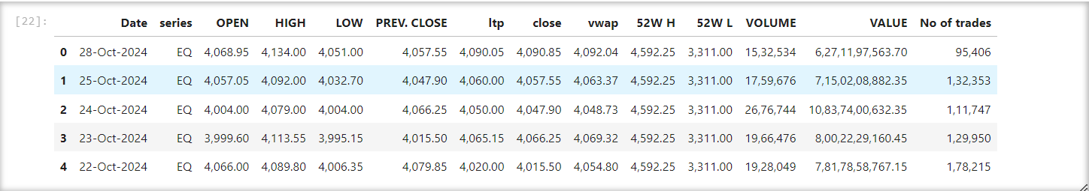
Data Preview

Slide 6
Data Preprocessing
Cleaned column names by stripping leading/trailing spaces.
Converted ‘Date’ column to datetime format.
Set ‘Date’ as index and ensured it is monotonic.
Set frequency of date index to business day.
Removed commas and converted ‘close’ column to float.
Handled missing values in the ‘close’ column by forward filling.

Slide 7
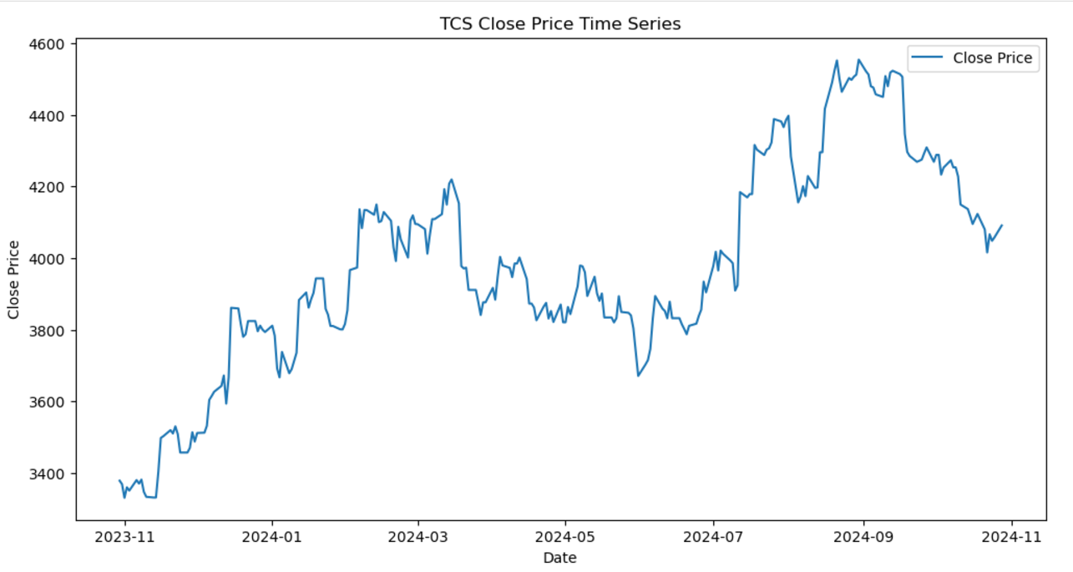
TCS Close Price Time Series

Slide 8
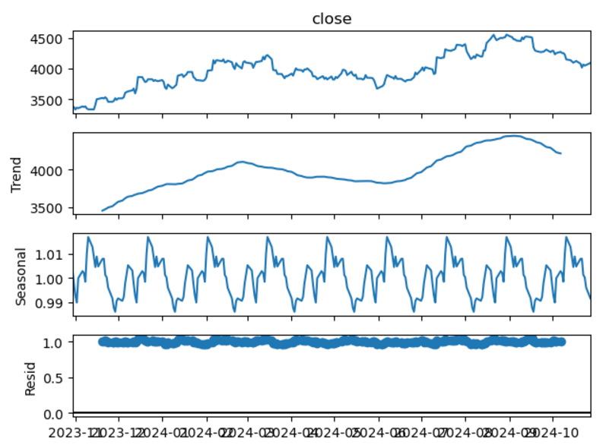
Seasonal Decomposition

Slide 9
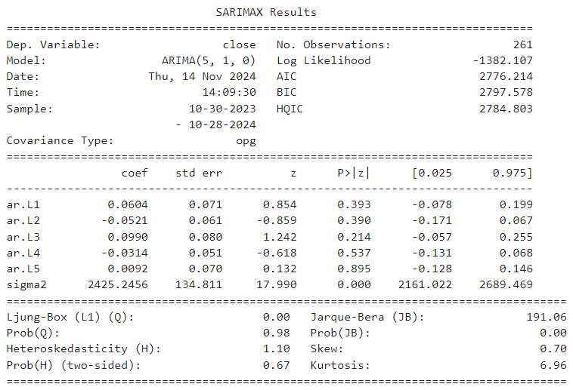
ARIMA Model Summary

Slide 10
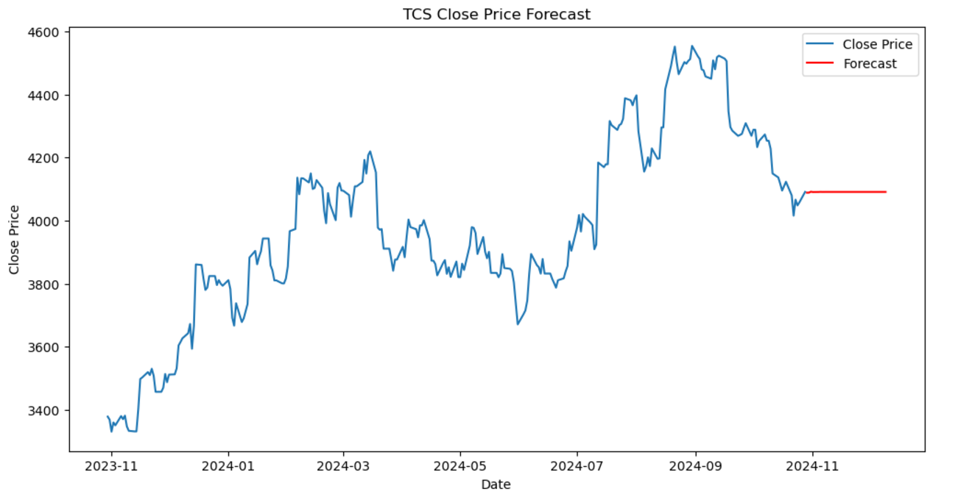
ARIMA Forecast Plot

Slide 11
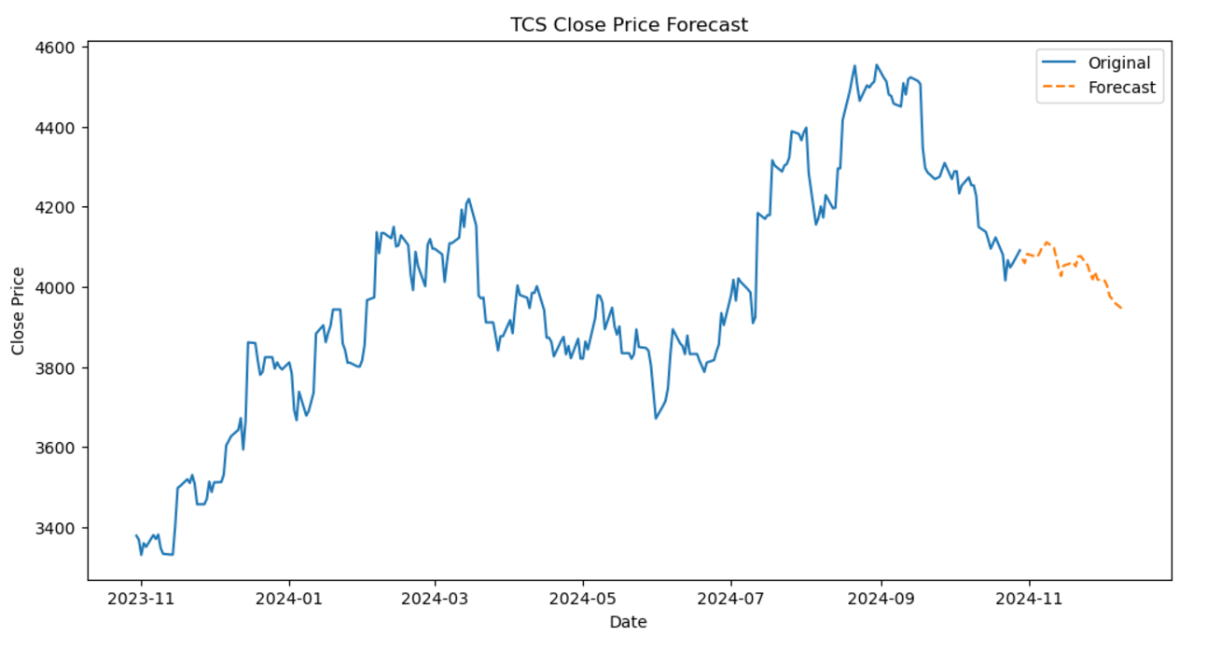
Holt-Winters Forecast Plot

Slide 12
Conclusion
Summary of Findings:
Identified significant trends and seasonal patterns in TCS close prices.
ARIMA and Holt-Winters models provided reliable forecasts for the next 30 business days.
Model Performance:
ARIMA captured short-term dependencies effectively.
Holt-Winters modeled seasonal patterns well.
Implications:
Forecasts are valuable for financial planning and decision-making.
Insights into trends and seasonality aid in informed investment decisions.

